Slide 1





Blockchain Composed
A Technical Introduction to Hyperledger Composer
Blockchain Explained
IBM Blockchain Platform
Blockchain Solutions
Blockchain Composed
Blockchain Architected
Blockchain Explored
V2.07, 23 January 2018
Next Steps
Notes:
This is a high level introduction to blockchain use-cases, references and IBM Blockchain. Presentations in this series are:
Blockchain Explained: High level introduction to blockchain for business
IBM Blockchain Platform Explained: Introduction to the IBM Blockchain Platform
Blockchain Solutions: Use-cases, references and how IBM can help
Blockchain Composed: A technical introduction to Hyperledger Composer
Blockchain Architected: A technical introduction to the concepts and components of a blockchain solution
Blockchain Explored: A technical deep dive on Hyperledger Fabric
Blockchain Next Steps: How to proceed on a first project
The latest copy of this presentation can be found on the IBM intranet at https://ibm.box.com/v/BlockchainSolutions. Feel free to distribute a PDF of this file to clients.

Slide 2
What is Hyperledger Composer?
Application Development
Writing the application
Modeling the business network
Effective Administration
Deploying to a blockchain
Interacting with systems of record
Notes:
This presentation is in three sections:
What is Blockchain: Covers the essentials of blockchain for business
Why is it relevant: Key use-cases
How can IBM help: IBM’s value proposition and the state of the technology

Slide 3
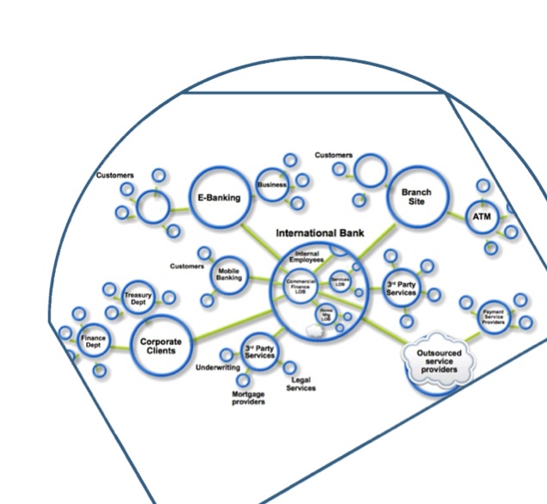
Blockchain Recap
Blockchain builds on basic business concepts
Business Networks connect businesses
Participants with Identity
Assets flow over business networks
Transactions describe asset exchange
Contracts underpin transactions
The ledger is a log of transactions
Blockchain is a shared, replicated ledger
Consensus, immutability, finality, provenance
Notes:
Purpose of the slide: Summarize the Blockchain Explained intro go give context to where Composer fits in
References: See First few slides from Blockhain Explained for details

Slide 4



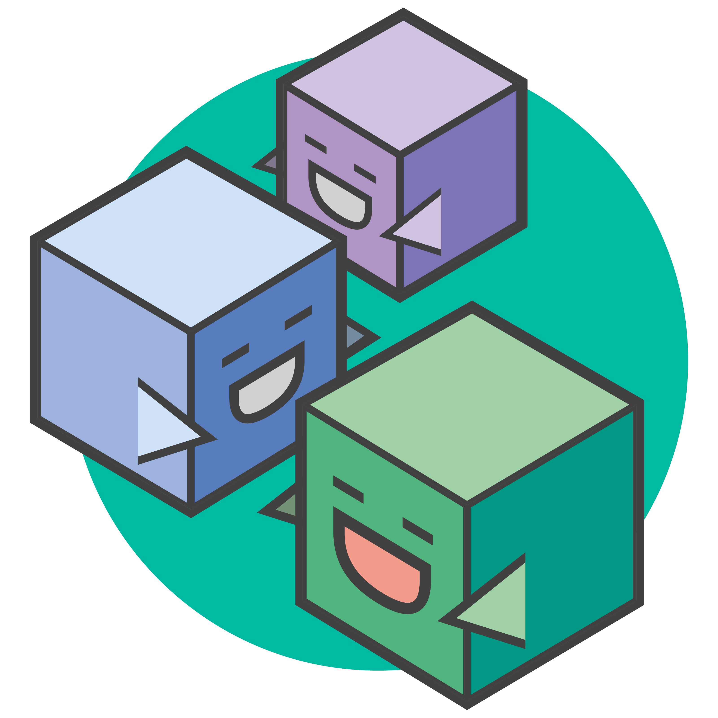
Hyperledger Composer: Accelerating time to value
https://hyperledger.github.io/composer/
Business Application
A suite of high level application abstractions for business networks
Emphasis on business-centric vocabulary for quick solution creation
Reduce risk, and increase understanding and flexibility
Hyperledger Composer
Blockchain (Hyperledger Fabric)
Features
Model your business networks, test and expose via APIs
Applications invoke APIs transactions to interact with business network
Integrate existing systems of record using loopback/REST
Fully open and part of Linux Foundation Hyperledger
Try it in your web browser now: http://composer-playground.mybluemix.net/
Notes:
Hyperledger Composer aims to bridge the gap between the high level abstractions that have been described in this presentation (i.e. assets, participants and transactions) and the technical realities of Hyperledger Fabric (i.e. invoking code on a distributed processing system).
By exposing a domain specific language and transaction processor functions in Javascript, the effect of Composer is that it allows you to develop blockchain applications very quickly. It saves time and increases flexibility.
Hyperledger Composer is now a Linux Foundation Hyperledger project. It requires Hyperledger Fabric.

Slide 5
Benefits of Hyperledger Composer
Increases understanding | Saves time | Reduces risk | Increases flexibility
Bridges simply from business concepts to blockchain | Develop blockchain applications more quickly and cheaply | Well tested, efficient design conforms to best practice | Higher level abstraction makes it easier to iterate
Notes:
Purpose: Why using Fabric Composer is great!
Say:
INCREASE UNDERSTANDING: With the language used by fabric composer is much more business friendly talking in Assets, Participants & Transactions enabling the gap between developers and business knowledge
SAVE TIME: Fabric composer has been built from the ground up with agile in min such as easy to test what was just written and using tools to turn what was created into live API’s and usable front end for end user testing in minutes
REDUCES RISK: with the increased ease of testing and ability for multiple personas to read and understand what has been written (amalgamation of previous 2 benefits) this provides much more stability and much more likely the end system will provide the business benefits required.
INCREASED FLEXIBILITY: As composer has been designed from agile developing, the ability to update the code and links to github to manage versioning then test this within minutes makes iterating imporvements easy.
References: Next slide shows how some of these benefits are realized with the tool choices

Slide 6
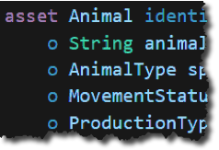
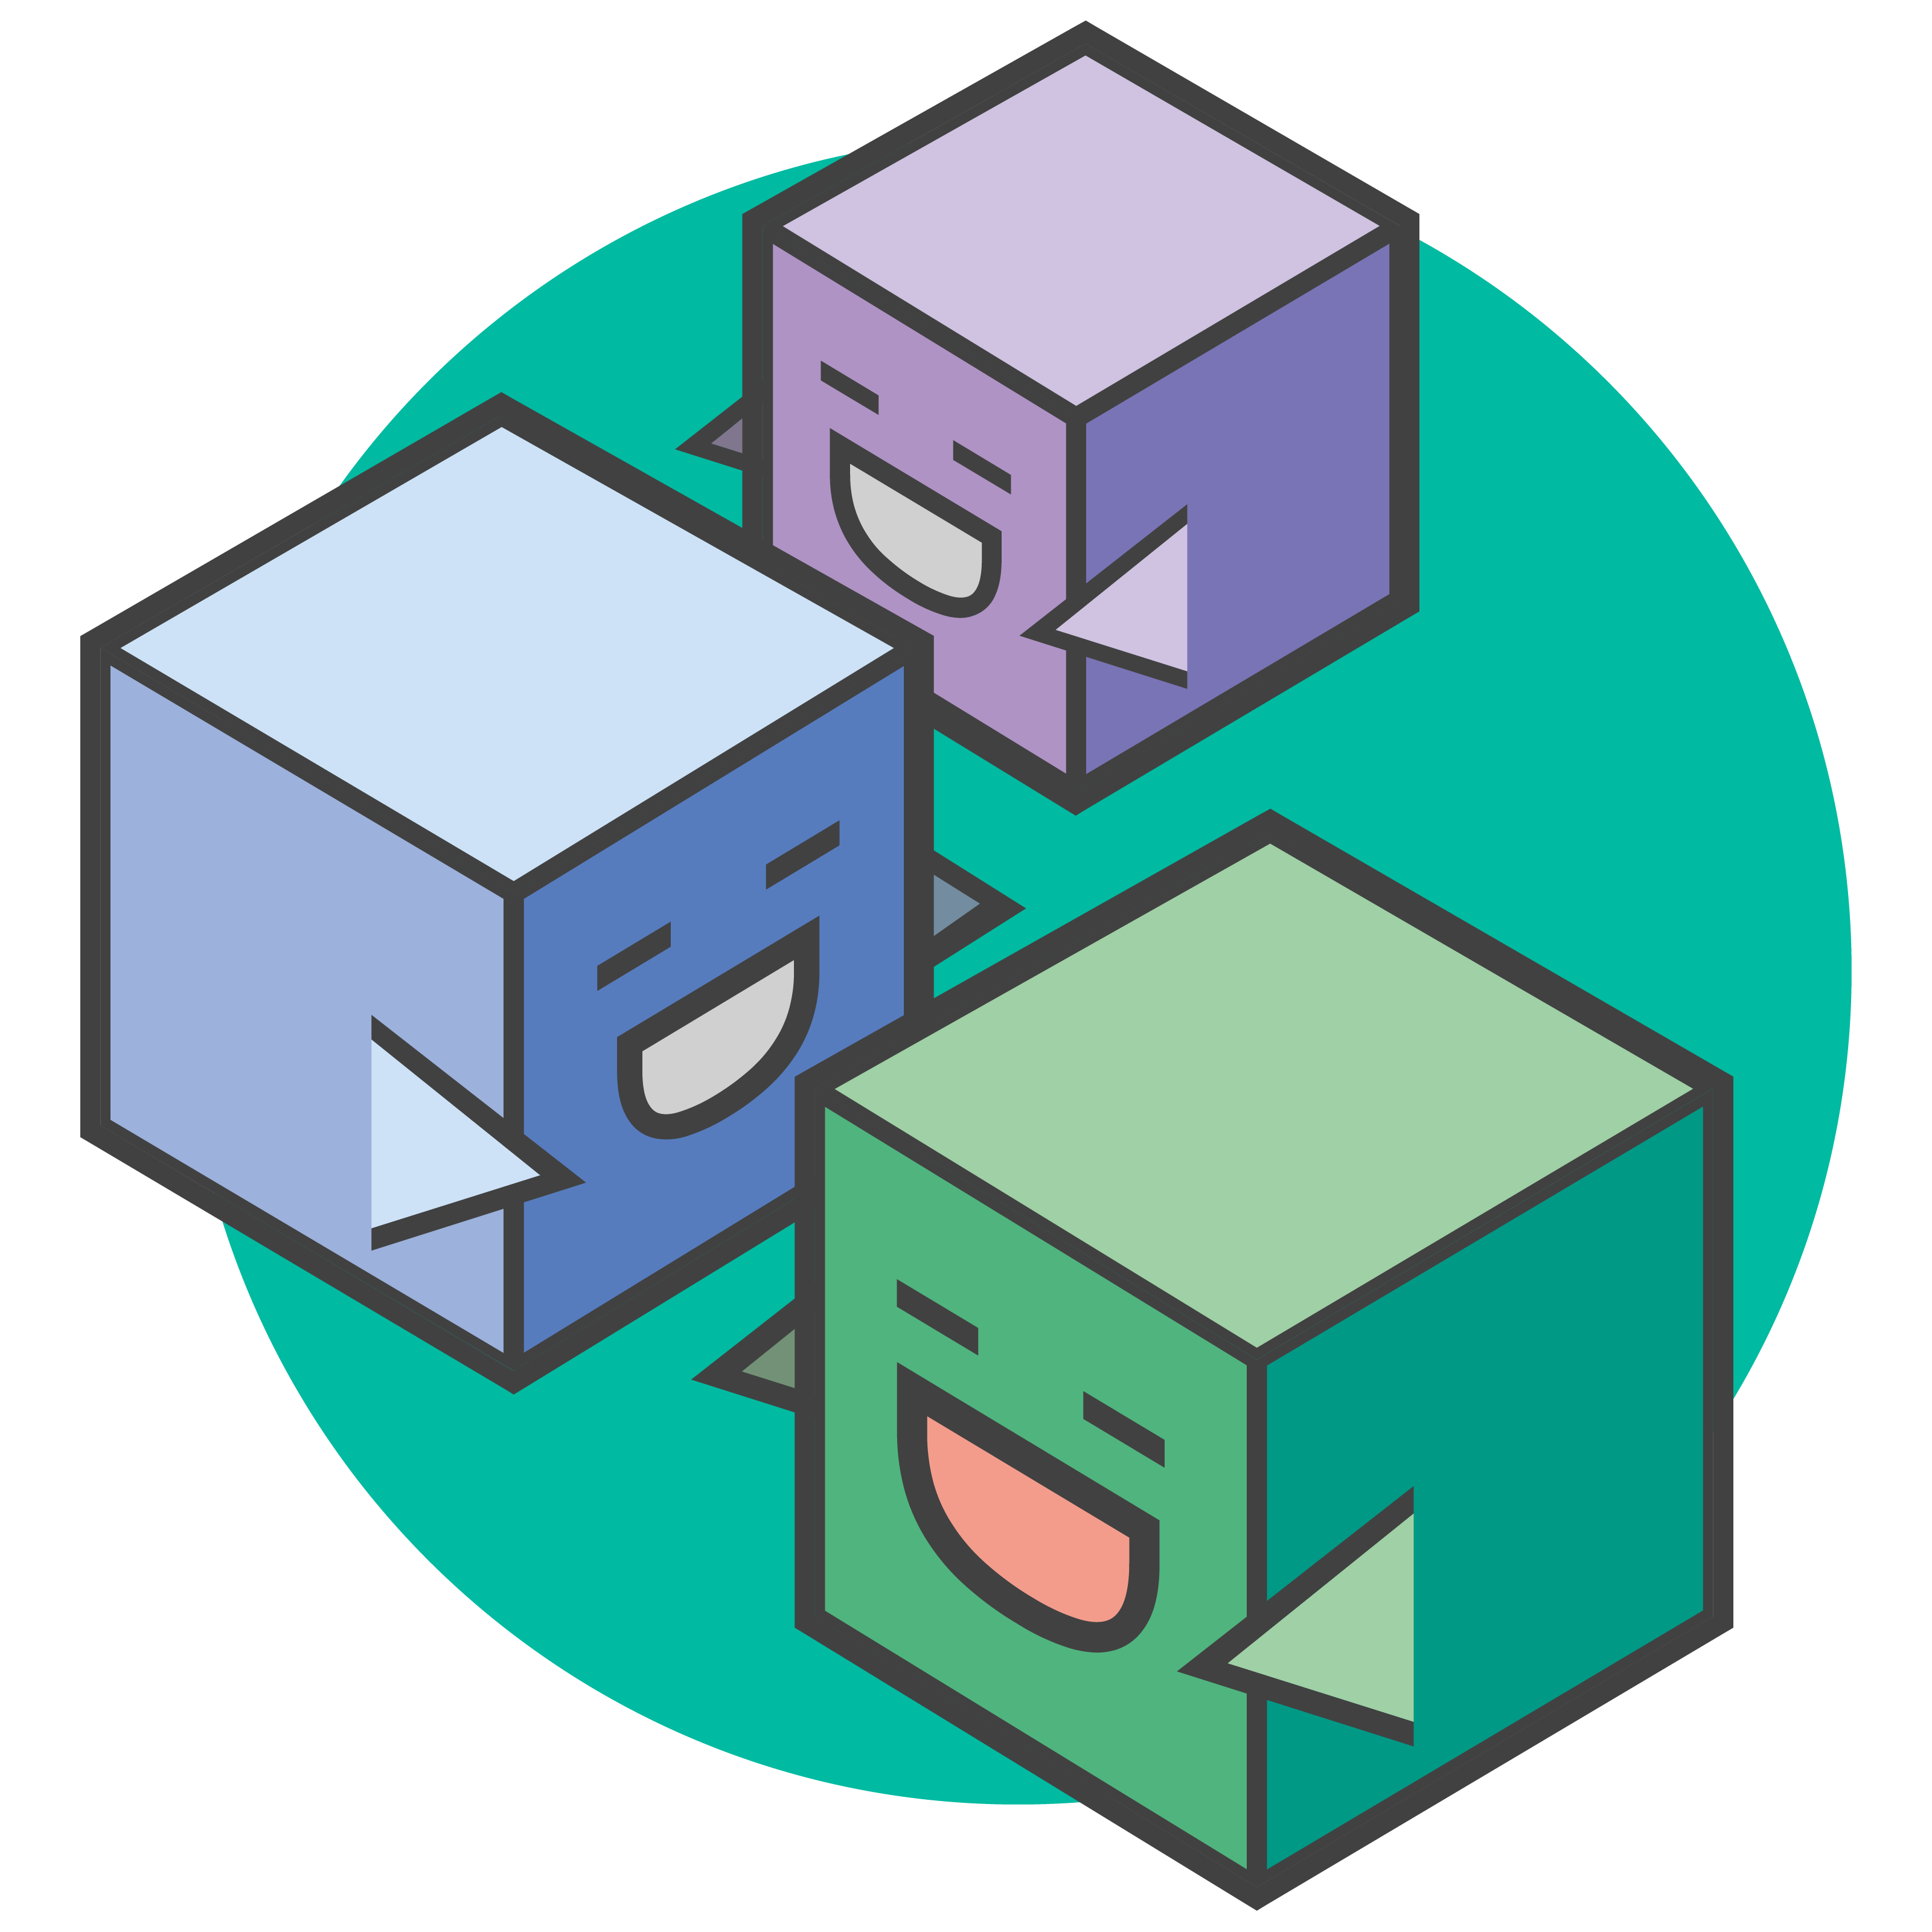
Extensive, Familiar, Open Development Toolset
Data modelling
JavaScript business logic
Web playground
Client libraries
composer-client
composer-admin
Editor support
CLI utilities
Code generation
Existing systems and data
$ composer
Swagger
Notes:
Purpose: Show the tools being worked with are familiar to many dev
Say: Most of these tools are commonly taught at uni so there is a large skill base to make use of when making blockchain
DATA MODELING: language is new language being looked at in more detail in a few slides but closely matches the realities of business. More on this later.
JAVA SCRIPT: one of the top 10 most popular languages and all decent computer science graduate will have some knowledge on how to program in this, also popular with more experienced developers
WEB PLAYGROUND: The playground is a web page that simulates having a blockchain and dev environement for you without needing to install anything. Load the page and get going. This is designed for developers or business analysts who want to get going quick to understand if this is something they can use, then later install the local version to use editors and connect to real blockchains. More on this later in pack. NPM is becoming very popular and an easy modular framework for developers to build upon. Various options available depending on your persona and what you need the tool to do
EDITOR: The framework will work allow any editor to be used, so far Atom & VisualStudio Code are supported, more will come as the open community adds their connectors – see anecdotes
CLI: a popular method of connecting to, managing and opperating systems o this is available complete with full help guides as standard in other CLI utilities
YO: Yoeman is a scaffolding tool for modern web apps. It can writing your build configuration (e.g Gulpfile) and pulling in relevant build tasks and package manage
EXISTING SYSTEMS: Loopback & Swagger (round green logo) are also open source projects. Loopback creates a full set of APIs for you based upon what have been made in Fabric Composer. Swagger is the most popular framework for APIs which visually renders your Swagger definition with concise, real time feedback and error handling
References & Anecdotes: Atom was planned to be our only initial editor supported, VS Code was added by one of our team familiar with VS code but not part of Composer dev team. Within a short amount of time he had

Slide 7

User Roles in a Blockchain Project
Network Service Provider
Governs the network: channels, membership etc.
A consortium of network members or designated authority
Network Service Consumer
Operates a set of peers and certificate authorities on the network
Represents an organization on the business network
Business Service Provider
Develops blockchain business applications
Includes transaction, app server, integration and presentation logic
NSP
Business Service Consumer
Hosts application and integration logic which invokes blockchain transactions
End-user
Runs presentation logic e.g. on mobile device or dashboard
A single organization may play multiple roles!
Notes:
A text-based description of each of the user roles a blockchain project.
Depending on the size and dynamics of the business network, note that a single organization may play multiple roles; for example, a network service provider might also run peers on the network.

Slide 8
The Developer Role in a Blockchain Project
Network Service Provider
Governs the network: channels, membership etc.
A consortium of network members or designated authority
Network Service Consumer
Operates a set of peers and certificate authorities on the network
Represents an organization on the business network
Business Service Provider
Develops blockchain business applications
Includes transaction, app server, integration and presentation logic
NSP
Business Service Consumer
Hosts application and integration logic which invokes blockchain transactions
End-user
Runs presentation logic e.g. on mobile device or dashboard
A single organization may play multiple roles!
Notes:
It is somewhat of a generalisation to group all development activity into the Business Service Provider role, as there are several components in a blockchain solution, which realistically might be developed by separate teams.

Slide 9
What is Hyperledger Composer?
Application Development
Writing the application
Modeling the business network
Effective Administration
Deploying to a blockchain
Interacting with systems of record
Notes:
This presentation is in three sections:
What is Blockchain: Covers the essentials of blockchain for business
Why is it relevant: Key use-cases
How can IBM help: IBM’s value proposition and the state of the technology

Slide 10
Key Concepts for the Business Service Provider
Business Service Provider
Presentation Logic
Smart Contract Logic
uses
develops
develops
End user
Model
Transaction Processor Functions
develops
calls
Assets
REST Interface
invokes transaction
hosts
Business App
updates
Integration Logic
Business Service Consumer
Asset Registry
Business Logic
defined in
Transaction Registry
defined in
updates
Participant Registry
Notes:
To read this chart, start at the Business Service Provider, which is the developer of the blockchain solution. In order to implement their Composer blockchain solution they need to implement (a) smart contract logic, (b) business logic and (c) presentation logic.
The end user uses the presentation logic to interact with the business logic tier, which are a set of services hosted by the Business Service Consumer. It is these services that invoke transactions that interact with the registries.

Slide 11


Key Concepts for a Vehicle Auction Developer
Vehicle Auction Developer
Mobile Auction App
Auction Smart Contract
uses
develops
develops
$
Balance
Member
Model
Place Offer
Close Bidding
develops
calls
REST Interface
Place Offer
Close Bidding
[Registry operations]
Vehicle
Vehicle Listing
Auction Back-end Service
hosts
updates
System of Record Integration
Auctioneer
Vehicle Registry
Vehicle Listing Registry
Business Logic
defined in
defined in
Transaction Registry
updates
Member Registry
Auctioneer Registry
Notes:
Registry Operations are the create, read, update and delete operations against the asset and participant registries

Slide 12
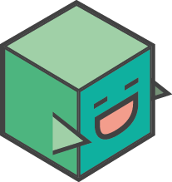

The Business Service Provider develops three components
Smart Contracts
Business Logic
Presentation Logic
Implements the logic deployed to the blockchain
Models describe assets, participants & transactions
Transaction processors provide the JavaScript implementation of transactions
ACLs define privacy rules
May also define events and registry queries
Services that interact with the registries
Create, delete, update, query and invoke smart contracts
Implemented inside business applications, integration logic and REST services
Hosted by the Business Application Consumer
Provides the front-end for the end-user
May be several of these applications
Interacts with business logic via standard interfaces (e.g. REST)
Composer can generate the REST interface from model and a sample application

Slide 13
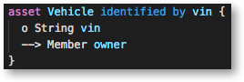
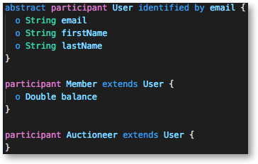
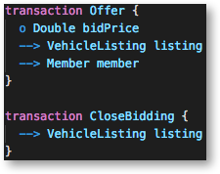
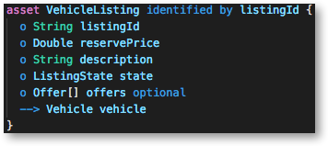
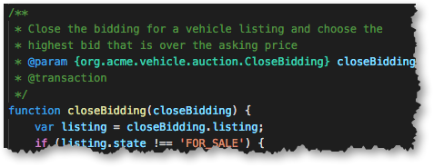
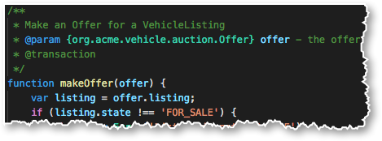
Assets, Participants and Transactions
Vehicle
Vehicle Listing
Place Offer
Close Bidding
Member
Auctioneer
Transaction Processors

Slide 14
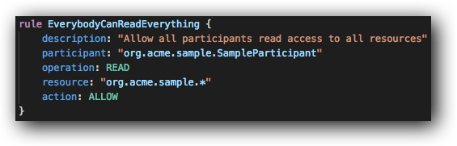
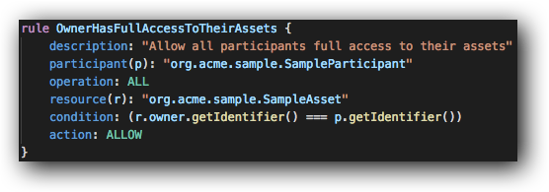
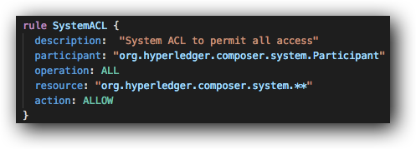
Access Control
It is possible to restrict which resources can be read and modified by which participants
Rules are defined in an .acl file and deployed with the rest of the model
Transaction processors can also look up the current user and implement rules programmatically
ACL rules can be simple (e.g. everybody can read all resources) or more complex (e.g. only the owner of an asset can do everything to it)
Application supplies credentials (userid/secret) of the participant when connecting to the Fabric network
This also applies to Playground!
Remember to grant System ACL all access if necessary

Slide 15
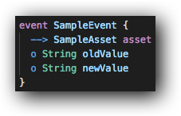
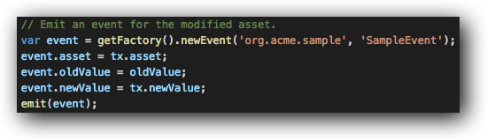
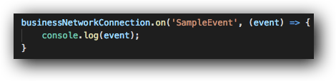
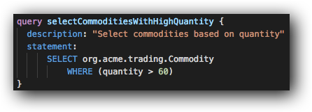
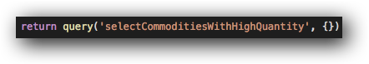
Events and Queries
Events allow applications to take action when a transaction occurs
Events are defined in models
Events are emitted by transaction processor scripts
Events are caught by business applications
Caught events include transaction ID and other relevant information
Queries allow applications to perform complex registry searches
They can be statically defined in a separate .qry file or generated dynamically by the application
They are invoked in the application using buildQuery() or query()
Queries require the blockchain to be backed by CouchDB

Slide 16
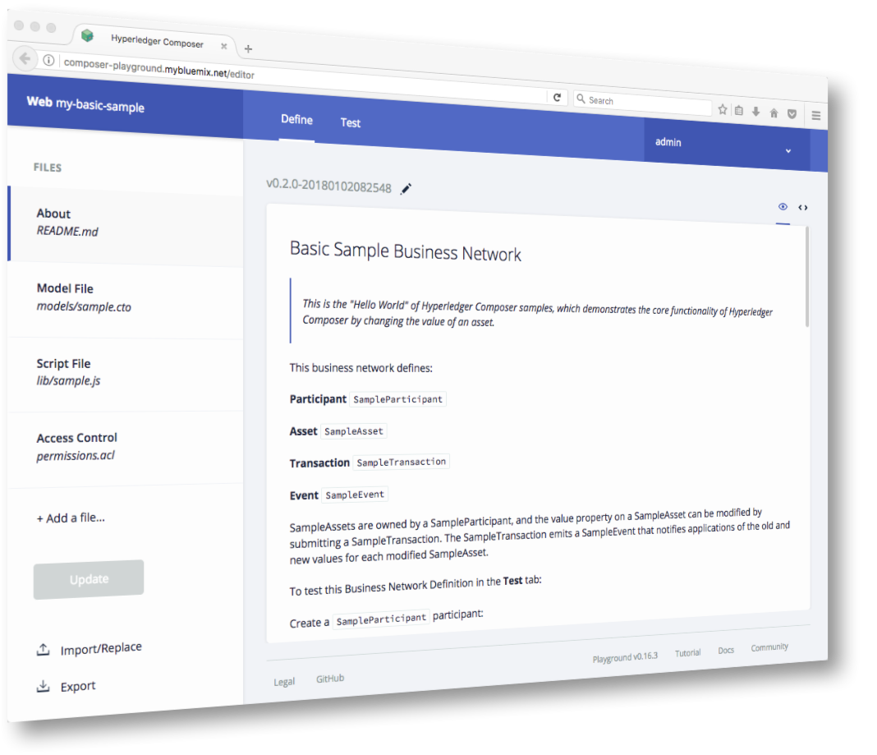
Smart Contract Development: Composer Playground
Web tool for defining and testing Hyperledger Composer models and scripts
Designed for the application developer
Define assets, participants and transactions
Implement transaction processor scripts
Test by populating registries and invoking transactions
Deploy to instances of Hyperledger Fabric V1, or simulate completely within browser
Install on your machine or run online at http://composer-playground.mybluemix.net

Slide 17
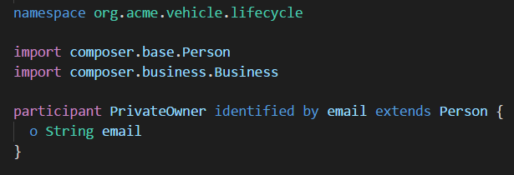
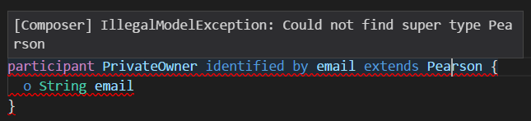
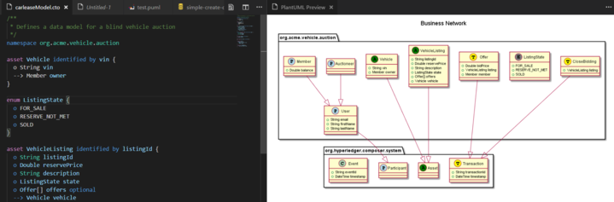
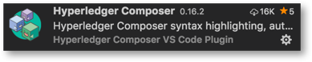
General purpose development: Visual Studio Code
Composer extension available for this popular tool
Features to aid rapid Composer development
Edit all Composer file types with full syntax highlighting
Validation support for models, queries and ACLs
Inline error reporting
Snippets (press Ctrl+Space for code suggestions)
Generate UML diagrams from models
Install directly from Code Marketplace

Slide 18



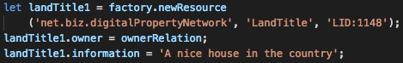


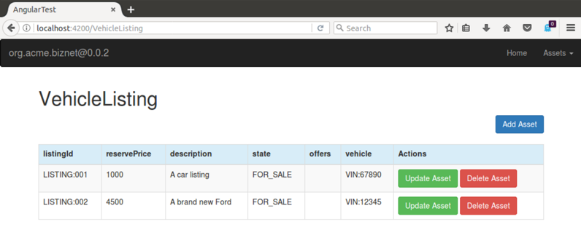
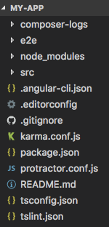
Creating the Business and End-User Applications
JavaScript business applications require() the NPM “composer-client” module
This provides the API to access assets, participants and transactions
RESTful API (via Loopback) can also be generated… see later
Command-line tool available to generate end-user command-line or Angular2 applications from model
Also helps with the generation of unit tests to help ensure quality code
model

Slide 19
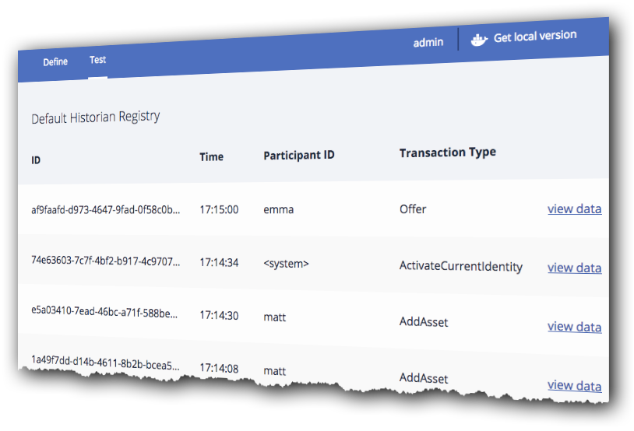
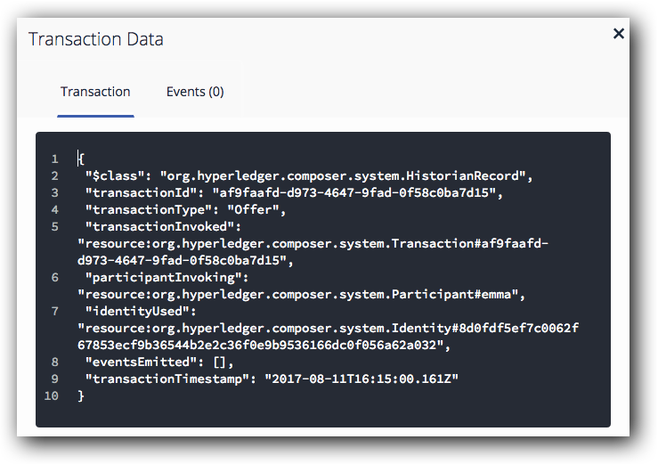
Debugging
Playground Historian allows you to view all transactions
See what occurred and when
Diagnostics framework allows for application level trace
Uses the Winston Node.js logging framework
Application logging using DEBUG env var
Composer Logs sent to stdout and ./logs/trace_<processid>.trc
Fabric chaincode tracing also possible (see later)
More information online:
https://hyperledger.github.io/composer/problems/diagnostics.html

Slide 20
What is Hyperledger Composer?
Application Development
Writing the application
Modeling the business network
Effective Administration
Deploying to a blockchain
Interacting with systems of record
Notes:
This presentation is in three sections:
What is Blockchain: Covers the essentials of blockchain for business
Why is it relevant: Key use-cases
How can IBM help: IBM’s value proposition and the state of the technology

Slide 21
There are Two User Roles with “Administration” Responsibility
Network Service Provider
Governs the network: channels, membership etc.
A consortium of network members or designated authority
Network Service Consumer
Operates a set of peers and certificate authorities on the network
Represents an organization on the business network
Business Service Provider
Develops blockchain business applications
Includes transaction, app server, integration and presentation logic
NSP
Business Service Consumer
Hosts application and integration logic which invokes blockchain transactions
End-user
Runs presentation logic e.g. on mobile device or dashboard
A single organization may play multiple roles!
Notes:
A text-based description of each of the user roles a blockchain project.
Depending on the size and dynamics of the business network, note that a single organization may play multiple roles; for example, a network service provider might also run peers on the network.

Slide 22
Key Concepts for Administrators
Network Service Consumer
Smart Contract Logic
packages
Business Network Archive
End user
Connection profile
creates
issues
issues
refers to
customizes and deploys
Business Service Consumer Identity
End-User Identity
REST Interface
connects
Asset Registry
Participant Registry
Transaction Registry
Identity Registry
Business App
hosts
Integration Logic
…
Business Network Card
Chaincode container
Ledger
Business Service Consumer
Business Logic
Hyperledger Fabric Peer
(Connection profile + Business Service Consumer Identity)

Slide 23
The Network Service Consumer packages resources into a BNA file
Business Network Archive (.BNA) is a package of the resources used by Fabric:
Model files (.CTO)
Transaction processors (.JS)
Access Control Lists (.ACL)
Static queries (.QRY)
Documentation and versioning (.MD)
It does not contain the client application
The BNA simplifies deployment of blockchain and promotion between environments
c.f. TAR, WAR, EAR, JAR, BAR…
Create BNA files from Playground or command line
Build from filesystem or NPM module
Business Network Archive
model.cto
logic.js
permissions.acl
?
queries.qry
readme.md
composer archive create –archiveFile my.bna
--sourceType module --sourceName myNetwork

Slide 24
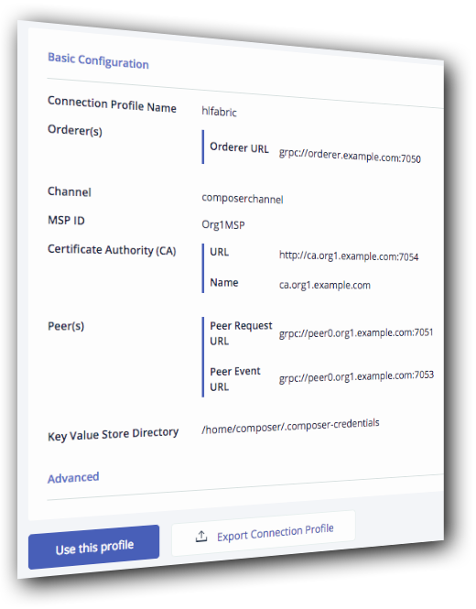
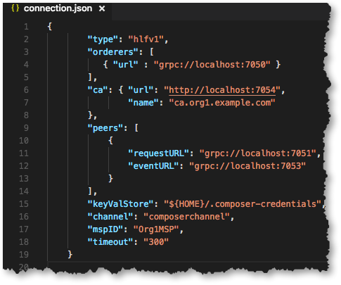
Connection Profiles to Hyperledger Fabric
Use connection profiles to describe Fabric connection parameters
One connection profile required per channel
Not necessary for web-based simulation
Enrollment in Hyperledger Fabric network required (see later)
Issue Fabric identity from Composer participants
Connection profiles currently used by Composer only
Plans to implement common connection profiles that can be used by both Fabric and Composer

Slide 25
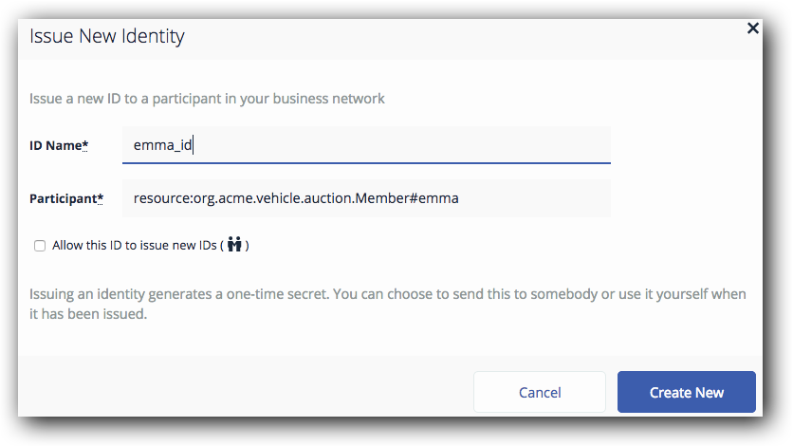
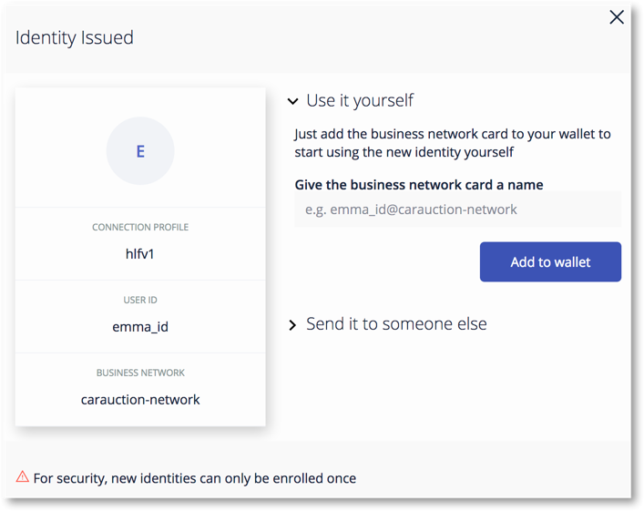
Participant Identity
The Network Service Consumer issues network participants with an identity in order to connect to Hyperledger Fabric
Issued as a Hyperledger Fabric userid/secret
Automatically swapped for a certificate on first use
Packaged in a Business Network Card and supplied when the client application connects
Composer Participant to Fabric Identity mapping is stored on the blockchain in an identity registry
Usually, only Business Service Consumers have a Fabric identity
End-users log in to the business application using a separately managed identity; blockchain transactions invoked by proxy
Manage identity from Playground, Javascript, REST or command line
For example: Test connection, issue identity, bind an identity to a participant, revoke an identity, list identities

Slide 26
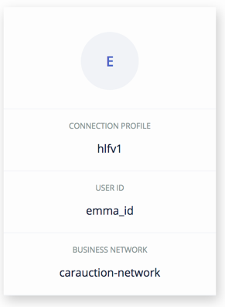
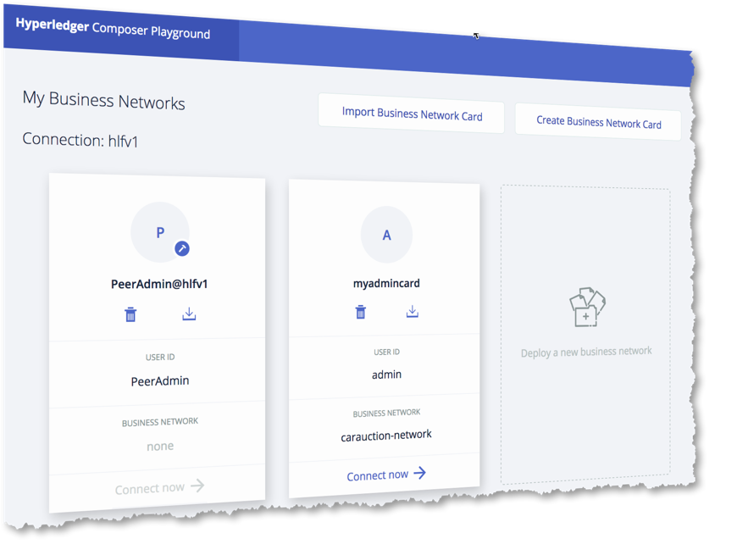
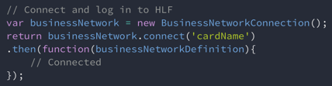
Business Network Cards
Business Network Cards are a convenient packaging of identity and connection profile
Contains everything you need to connect to blockchain business network
Each card refers to a single participant and single business network
Analogous to an ATM card
Manage cards from both Playground and command-line
Create, delete, export, import, list
Create requires userid/secret or certificate/private key
Use cards to connect to Fabric from Playground, command-line or from within your application
composer network deploy -a my.bna -c my.card
Notes:
Note also: Each Hyperledger Fabric channel requires a special ‘peeradmin’ card for deploying initial Hyperledger Composer chaincode

Slide 27
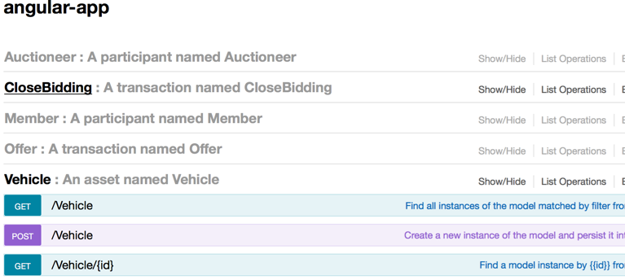
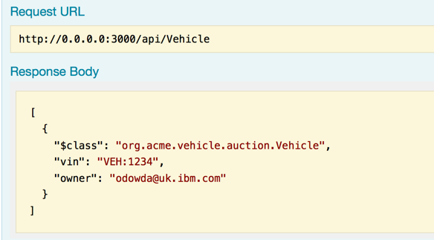
Systems of Record Integration
Domain specific APIs very attractive to mobile and web developers. Resources and operations are business-meaningful
Composer exploits Loopback framework to create REST APIs: https://loopback.io/
Extensive test facilities for REST methods using loopback
Secured using JS Passport, giving >400 options for authentication
Composer provides back-end integration with any loopback compatible product
e.g. IBM Integration Bus, API Connect, StrongLoop
Outbound and Inbound (where supported by middleware)

Slide 28
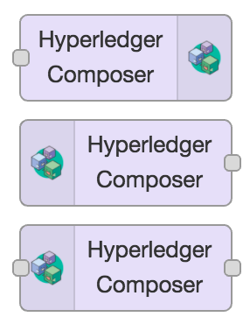
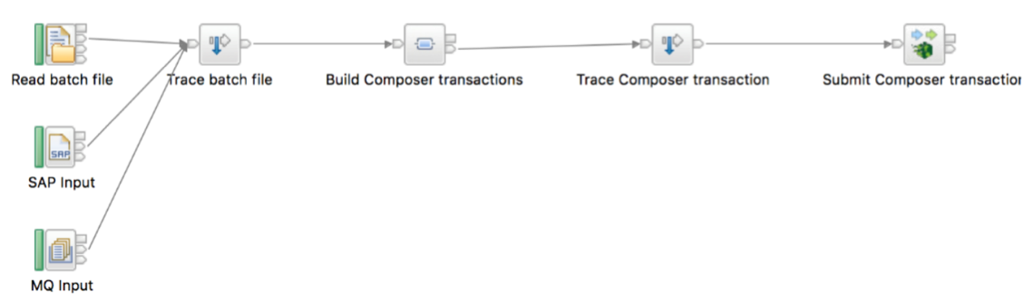
Exploiting Loopback: Examples
IBM Integration Bus
IIB V10 contains Loopback connector
Example above takes input from file, SAP or MQ
Data mapping from CSV, BAPI/IDOC or binary form to JSON model definition
Node.RED
Pre-built nodes available for Composer
Connect to hardware devices, APIs and online services
Install direct from Node.RED UI
Manage Palette -> Install -> node-red-contrib-composer

Slide 29
How Composer Maps to Fabric Chaincode
Composer
Client
Fabric
Client
Composer Chaincode
(Go)
Composer Runtime (JS)
End-User
Code
(JS)
Duktape JS VM
Events
Fabric
Shim
(Go)
Hyperledger Fabric Peer
Each Business Network is deployed to its own chaincode container
Container contains a static piece of Go chaincode that starts a Javascript virtual machine running transaction processors
Browse these containers to view diagnostic information (docker logs)
Embedded chaincode is not a Composer external interface

Slide 30
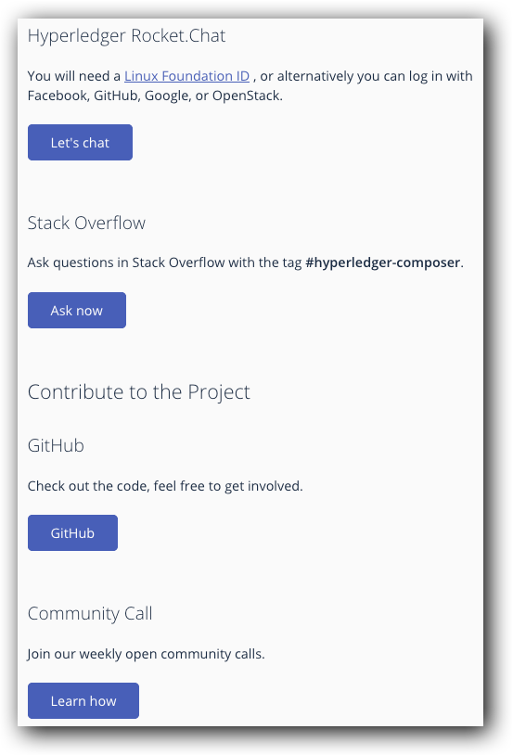
Hyperledger Composer Outlook
Still early in product lifecycle
Lots of improvements planned
See https://github.com/hyperledger/composer/issues
An active development community
Open community calls every two weeks
Rocket Chat
Stack Overflow
Get involved!

Slide 31
Get started with Hyperledger Composer
Define, Test and Deploy Business Networks
Create domain APIs and sample applications
Integrate existing systems and data
https://hyperledger.github.io/composer/
http://composer-playground.mybluemix.net/

Slide 32
Thank you
www.ibm.com/blockchain
developer.ibm.com/blockchain
www.hyperledger.org
© Copyright IBM Corporation 2017. All rights reserved. The information contained in these materials is provided for informational purposes only, and is provided AS IS without warranty of any kind, express or implied. Any statement of direction represents IBM's current intent, is subject to change or withdrawal, and represents only goals and objectives. IBM, the IBM logo, and other IBM products and services are trademarks of the International Business Machines Corporation, in the United States, other countries or both. Other company, product, or service names may be trademarks or service marks of others.

